Slide 1
PM2.5 prediction
- Pranav Nambiar

Slide 2
Details
Github: https://github.com/PranavNambiar123/PM2.5-Prediction-Project-IIT-Kanpur
Roll number: 233562458
IITK email: nambiarpv23@iitk.ac.in

Slide 3
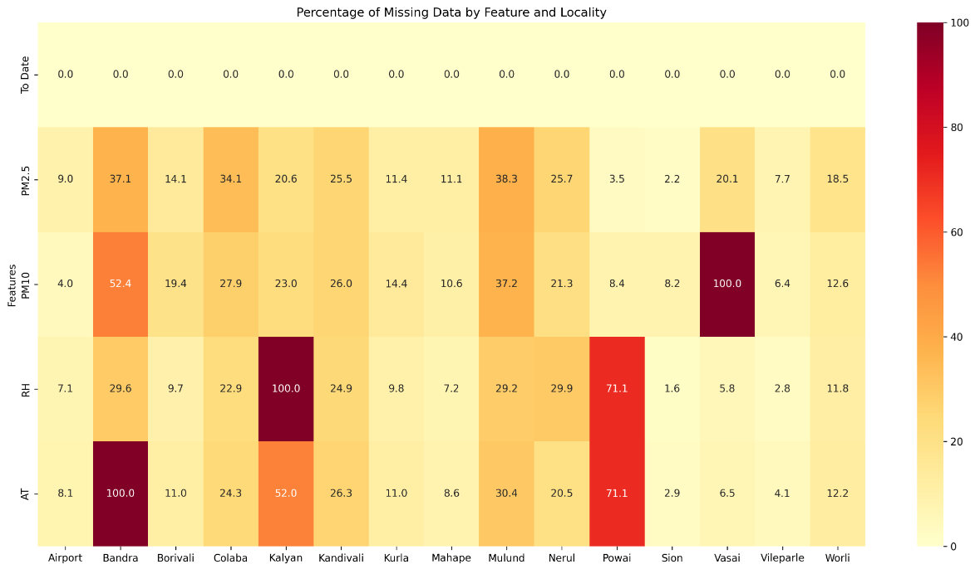
Data visualizations and analysis

Slide 4
Analysis of missing data
Airport, Borivali, Kurla, Mahape, Sion, Vileparle and Worli have relatively smooth data with missing data percentages being lower than 15-20% for each. We can perform feature analysis using these localities for good data analysis
For the rest of the localities we need to perform different data transformations
Mean/Median/Mode
Eliminate the missing data events
Linear interpolation (filling data between 2 non empty events linearly)
Average of data of surrounding localities
More plots information here

Slide 5
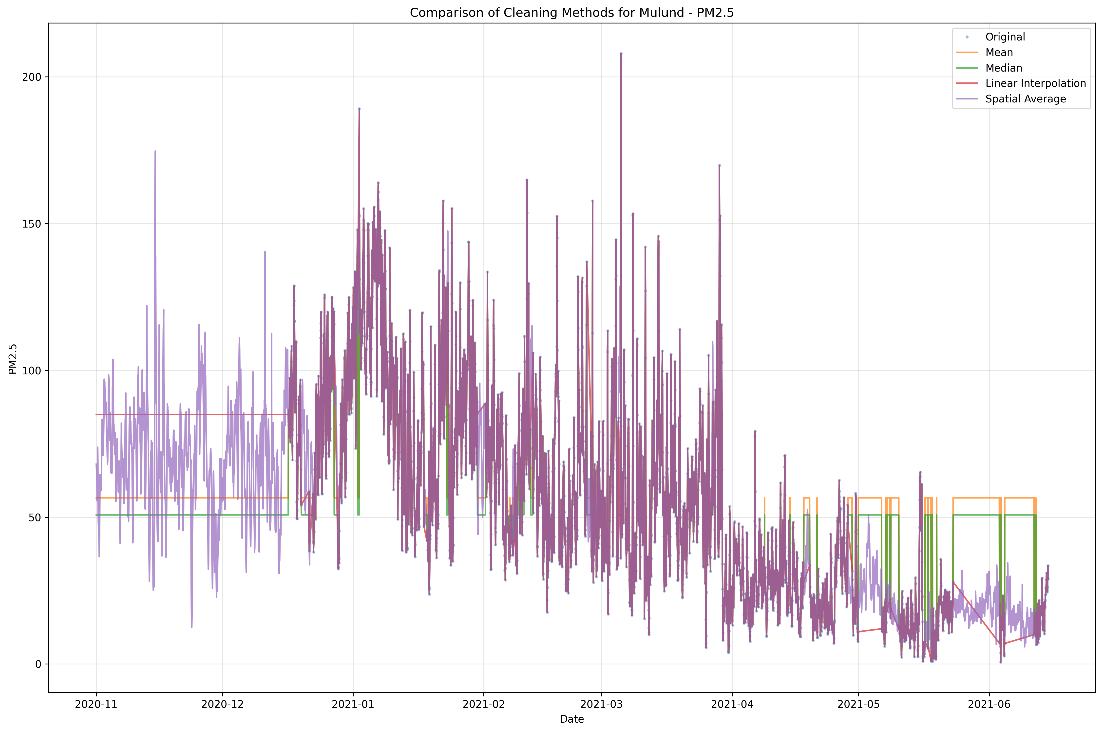
Performing cleaning methods, comparison
Visually seems spatial average will be the best Will know for sure once we test using models

Slide 6
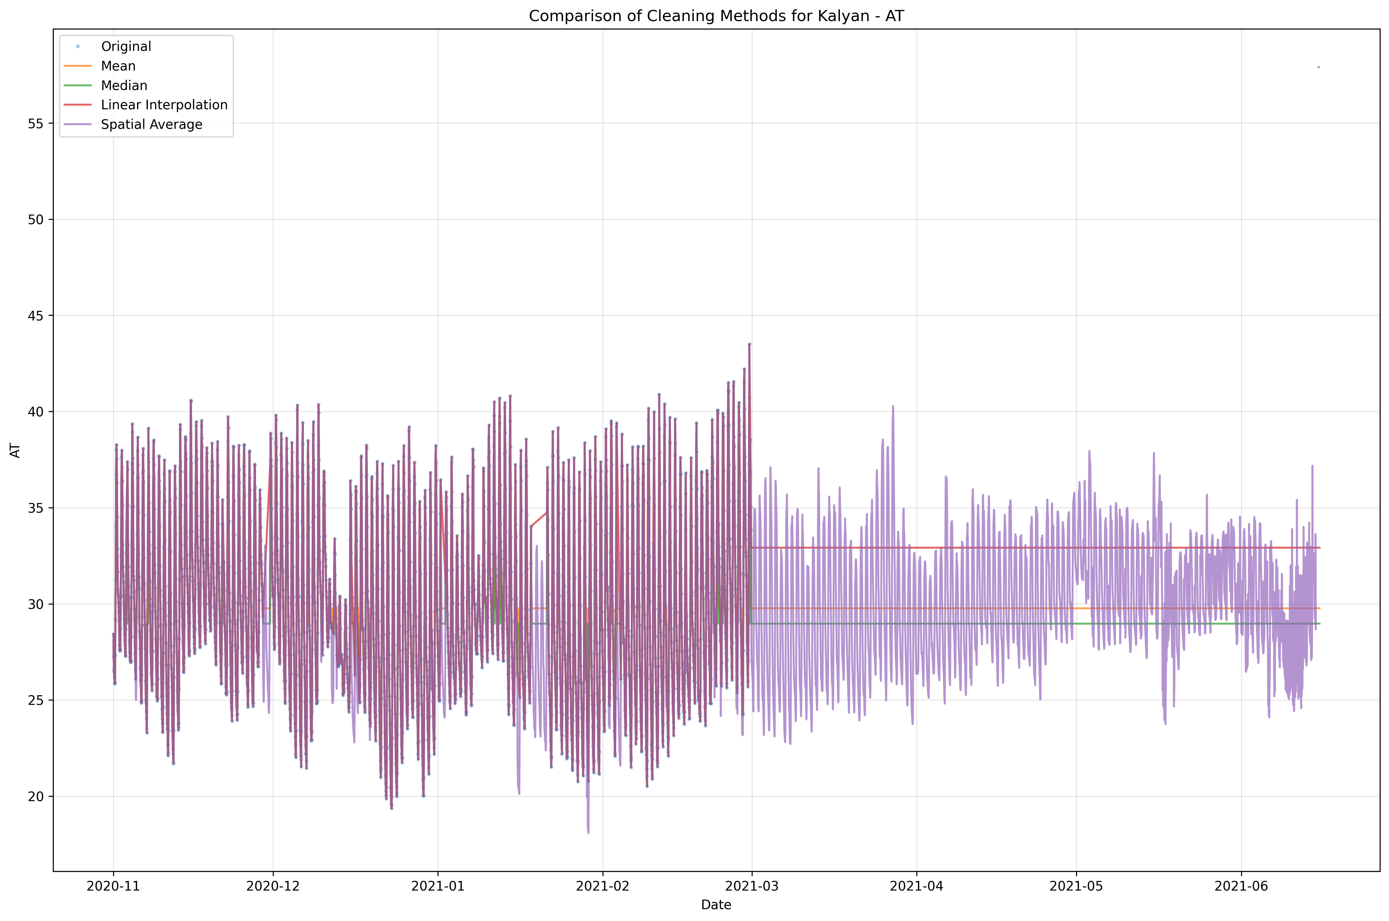
Performing cleaning methods, comparison
This has over 50% data missing

Slide 7
Cleaning methods, comparison
Cleaned and updated all data here: https://github.com/PranavNambiar123/PM2.5-Prediction-Project-IIT-Kanpur/tree/pranavProject/cleaned_data
Cleaned each locality data individually

Slide 8
Data Quality by Station:
Best quality stations (>90% complete PM2.5 data):
Sion (97.8%)
Powai (96.5%)
Vileparle (92.3%)
Airport (91.0%)
Moderate quality (75-90% complete PM2.5 data):
Kurla (88.6%)
Mahape (88.9%)
Borivali (85.9%)
Worli (81.5%)
Vasai (79.9%)
Kalyan (79.4%)
Lower quality (<75% complete PM2.5 data):
Kandivali (74.5%)
Nerul (74.3%)
Colaba (65.9%)
Bandra (62.9%)
Mulund (61.7%)

Slide 9
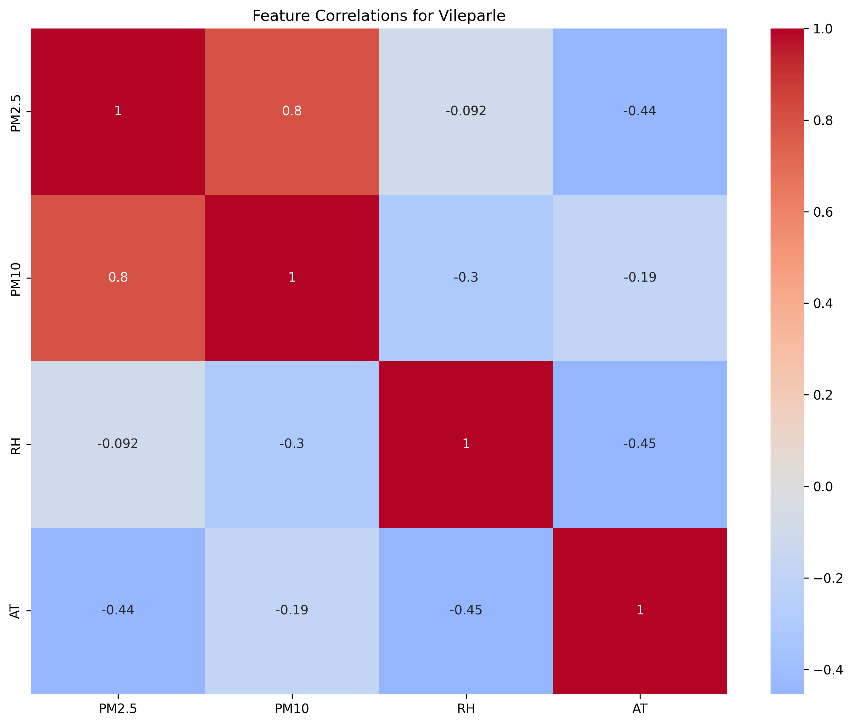
Feature correlation

Slide 10
Feature correlation
Performed feature correlation for Vile Parle as it is one of the most complete dataset
There is a high correlation between PM2.5 and PM10. When PM2.5 increases, PM10 also increases in a similar manner
There is weak negative correlation between PM2.5 and Relative humidity. There is almost no linear relationship
There is moderate negative correlation between PM2.5 and Air Temperature. If temperature increases PM2.5 decreases and vice versa

Slide 11
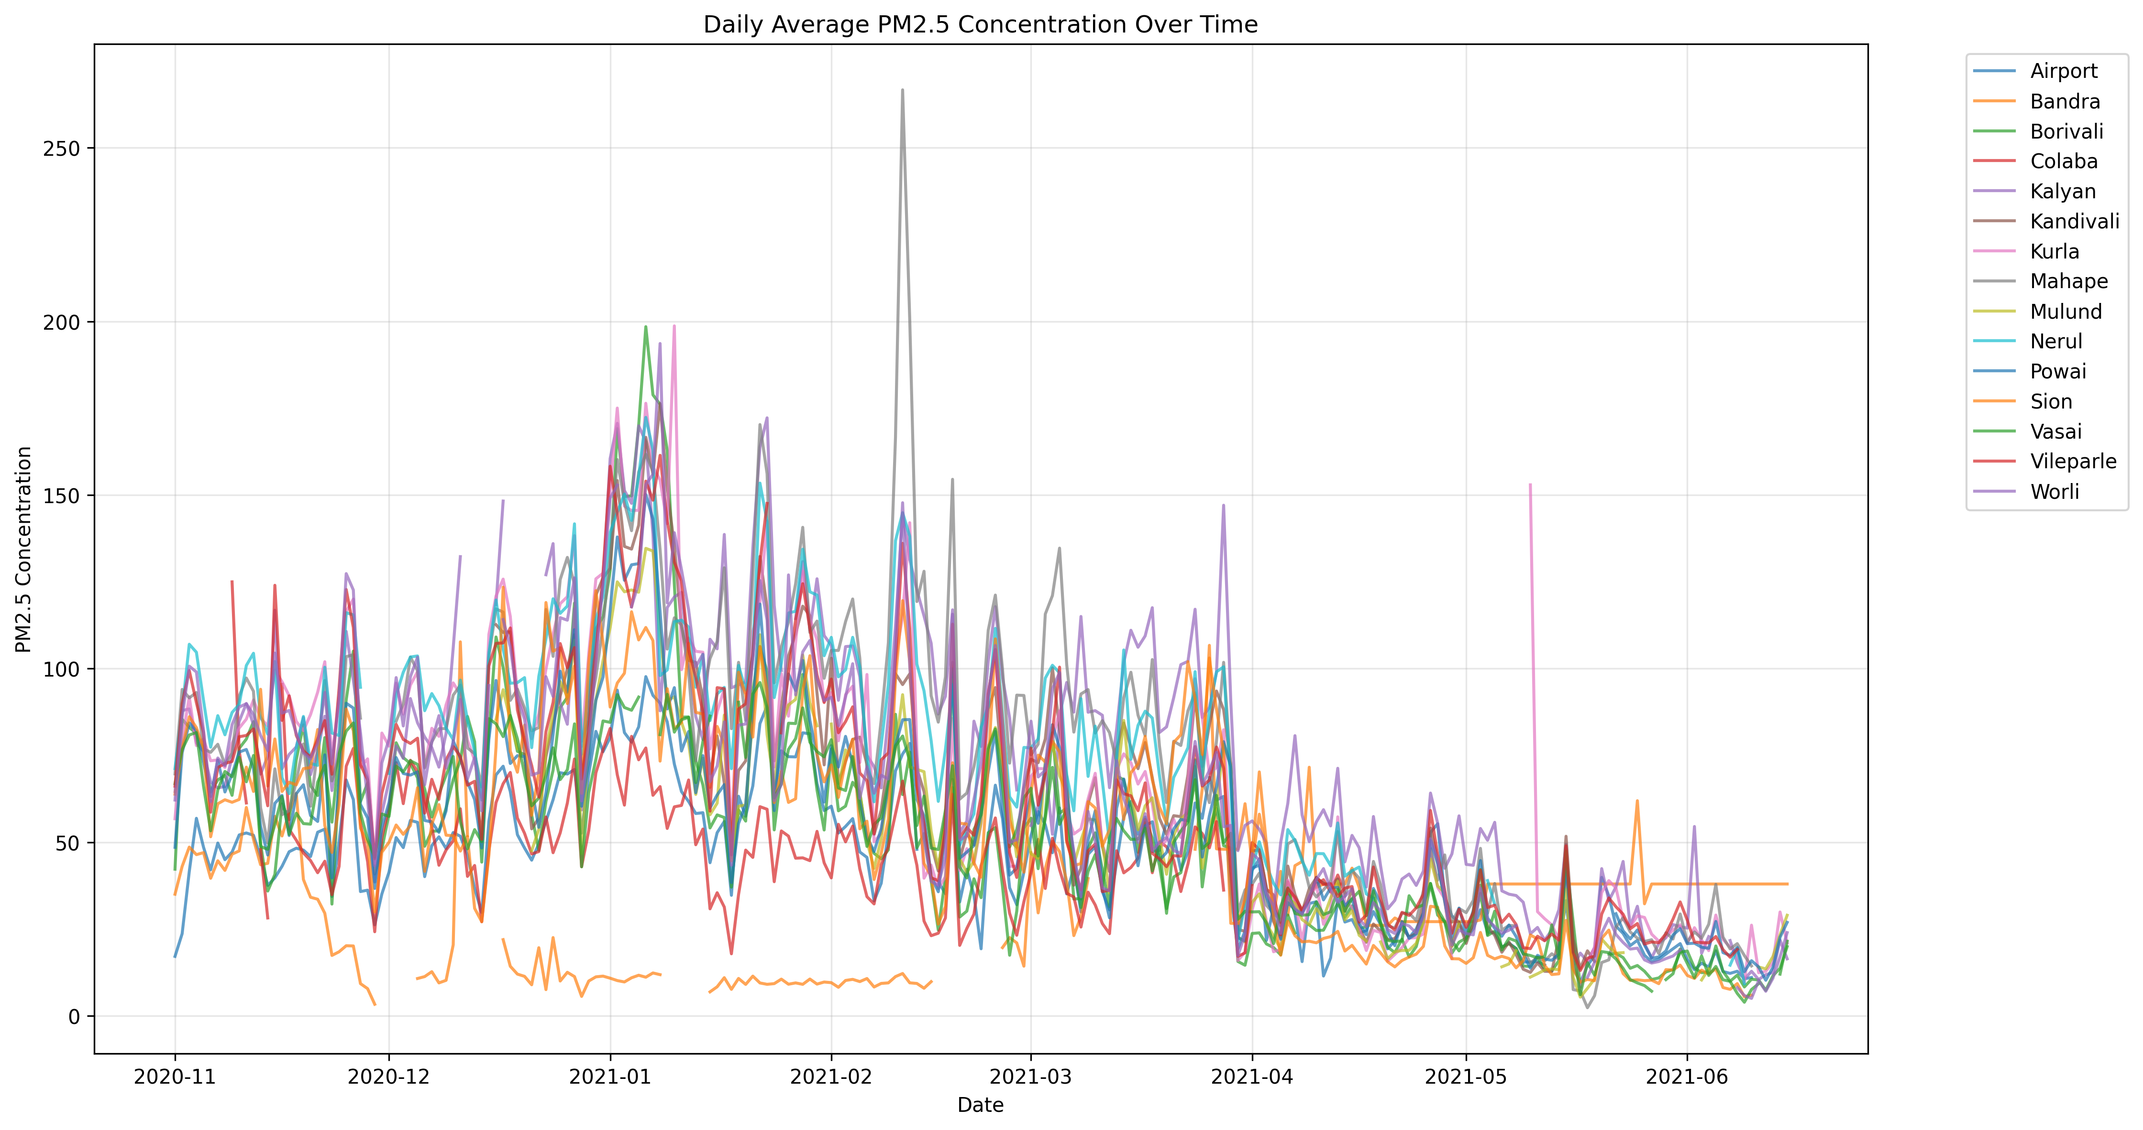
PM2.5 Patterns over period of time
Doesn’t tell a lot except seasonal information of PM2.5

Slide 12
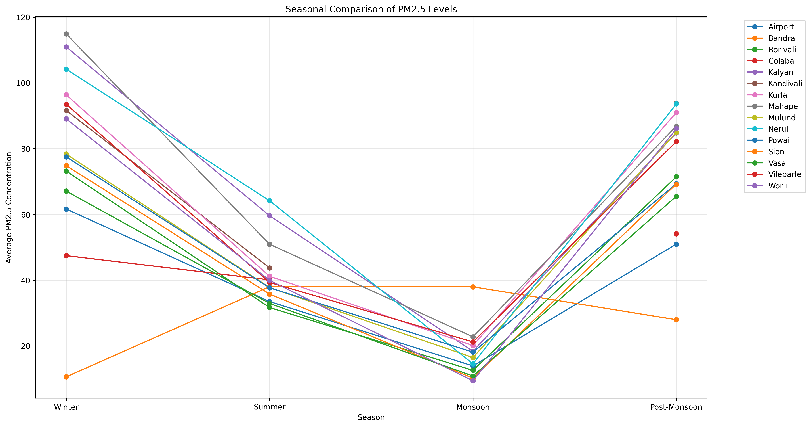
PM2.5 average patterns over seasons
It tends to go up during winter and come down during summer and least in monsoon due to rain

Slide 13
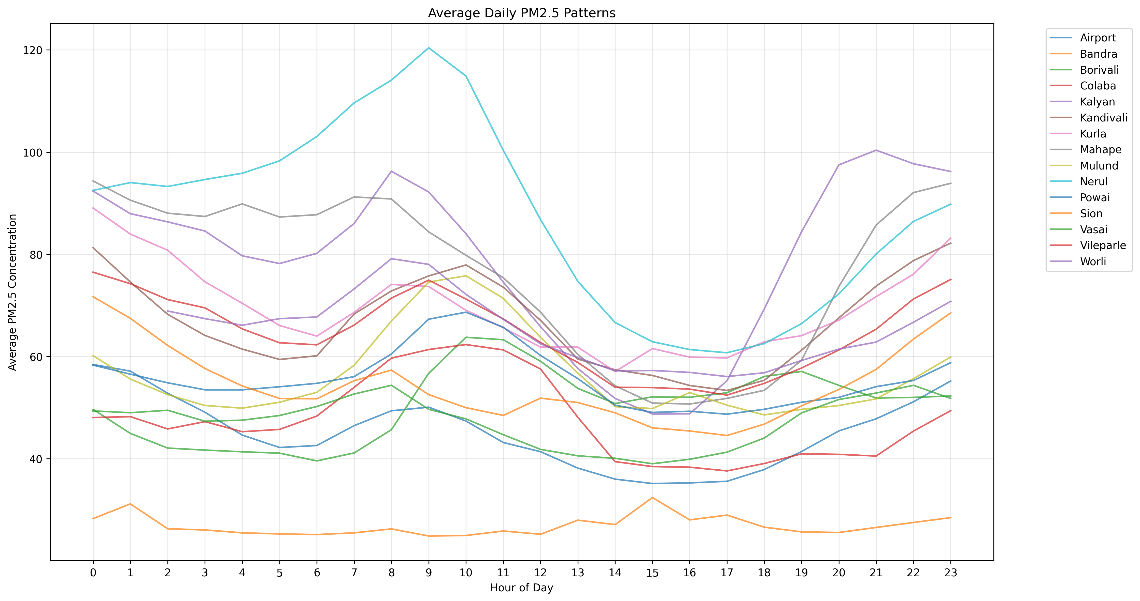
Average PM2.5 for each hour of the day
The peak PM2.5 hours are morning 9 AM and evening 7-8 pm which are also peak rush hours Most people leave office at these hours and a lot of vehicles enter the roads

Slide 14
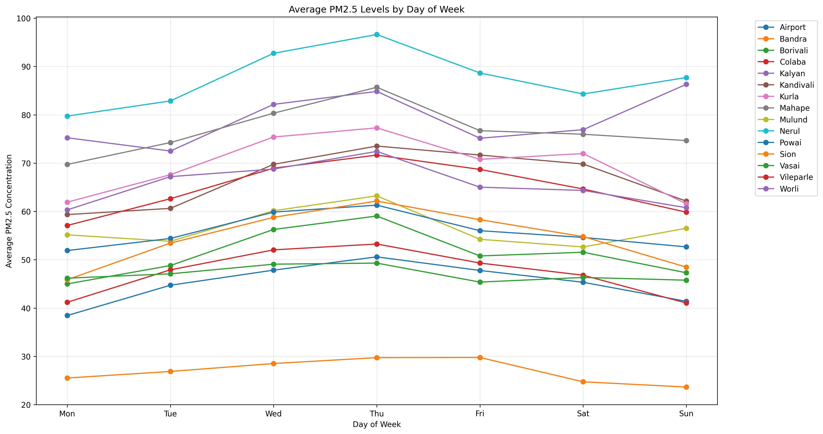
PM2.5 average over each day of the week
PM2.5 goes down over the weekend for most localities. Except localities like Worli, Mulund
Known for their party scenes

Slide 15
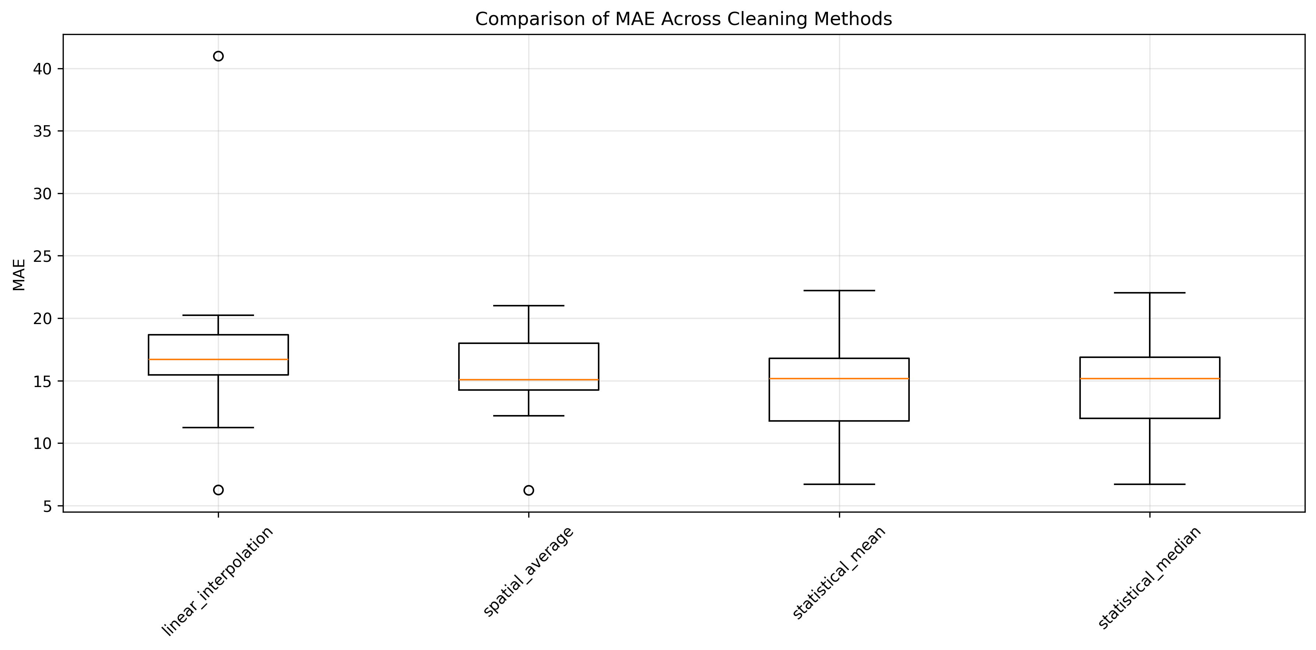
Linear Regression Results (MAE)

Slide 16
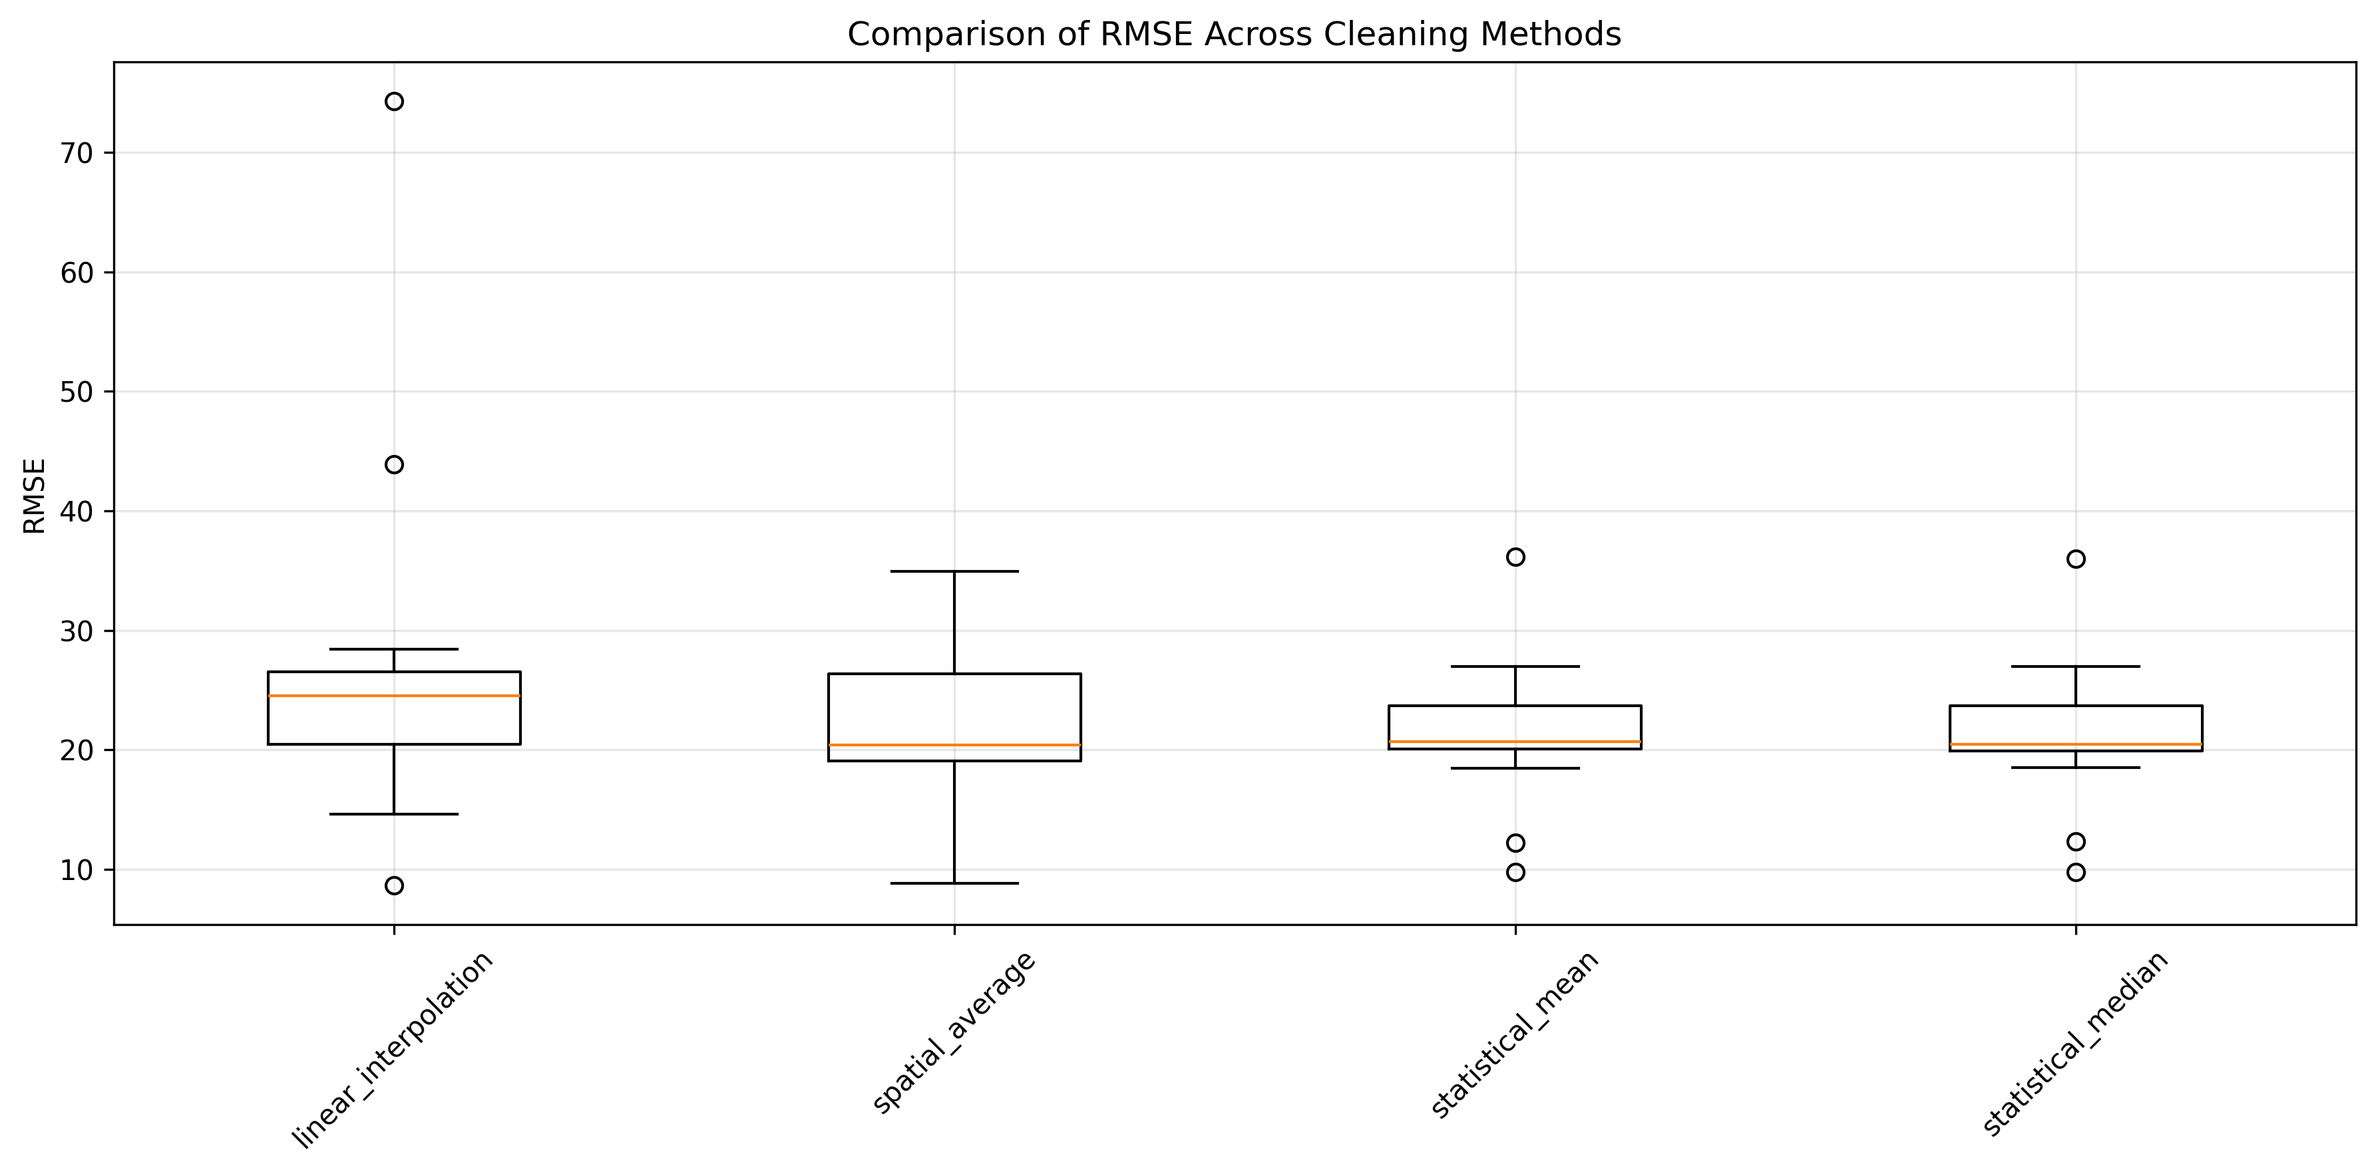
Linear Regression Results (RMSE)

Slide 17
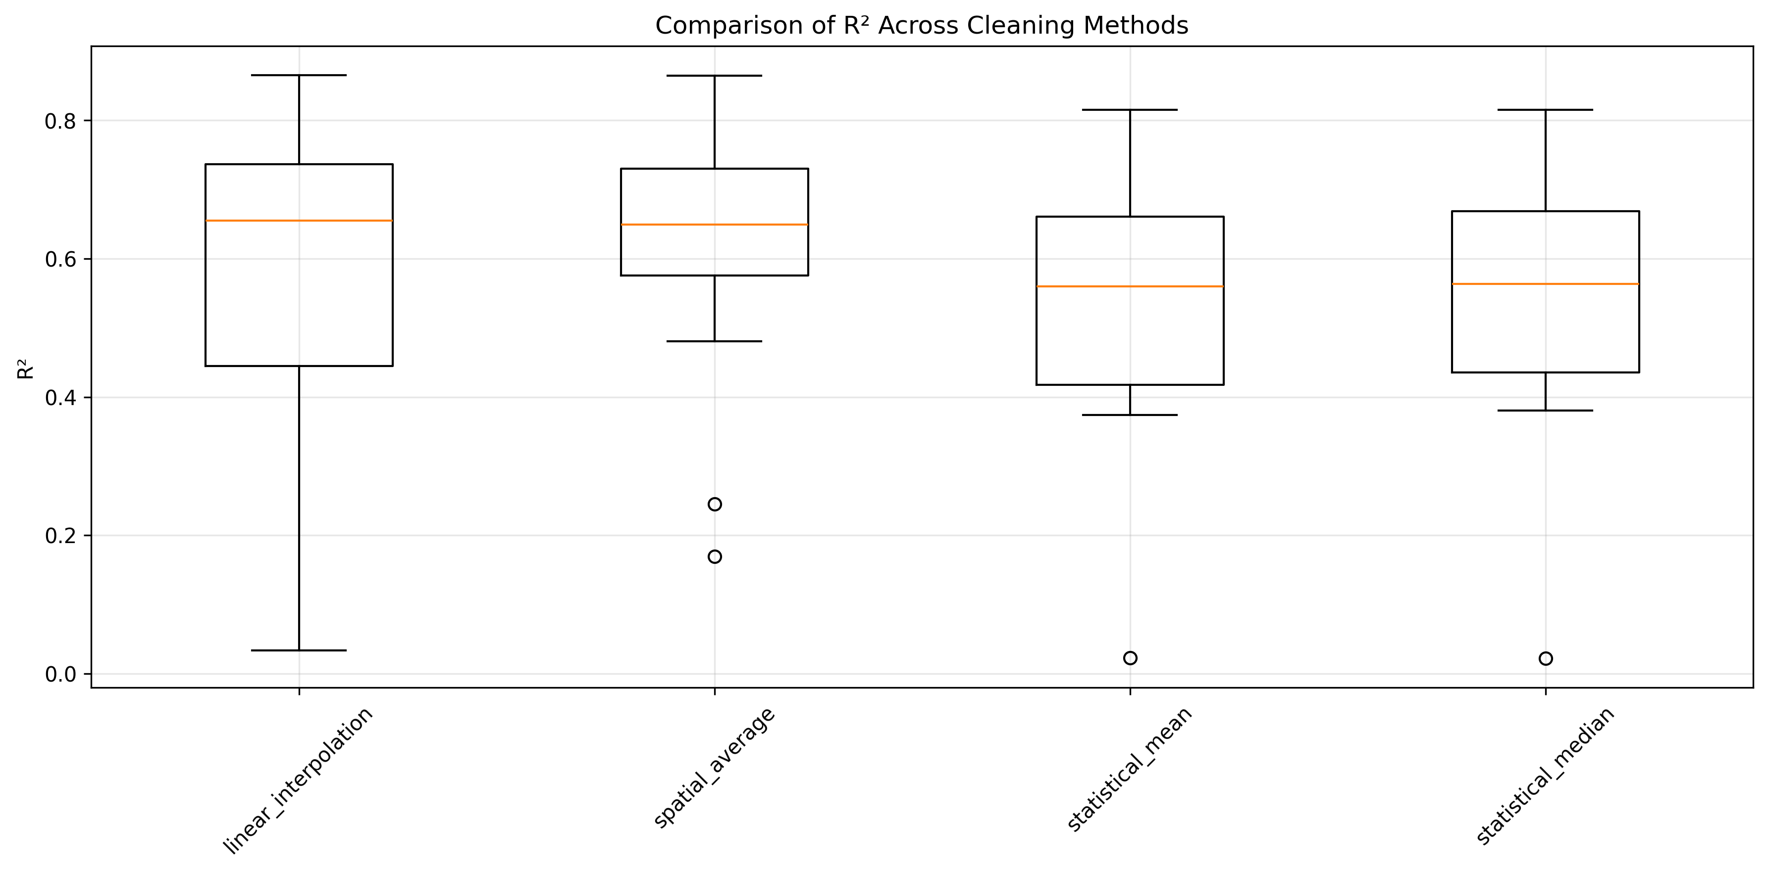
Linear Regression Results (R2)

Slide 18
Linear Regression Results Analysis
The results of RMSE and MAE of around 25 and 20 respectively are quite bad considering Mumbai’s PM2.5 generally ranges between 50 and 100
The boxplots however show that spatial average (performing average of all data points across localities) is the one with the best performing results
However the box is skewed to the bottom meaning the upper part of the data has more spread and there existing some high values
Linear interpolation also worked almost as well as spatial average
The mean/median method however worked relatively poorly against both the above mechanisms

Slide 19
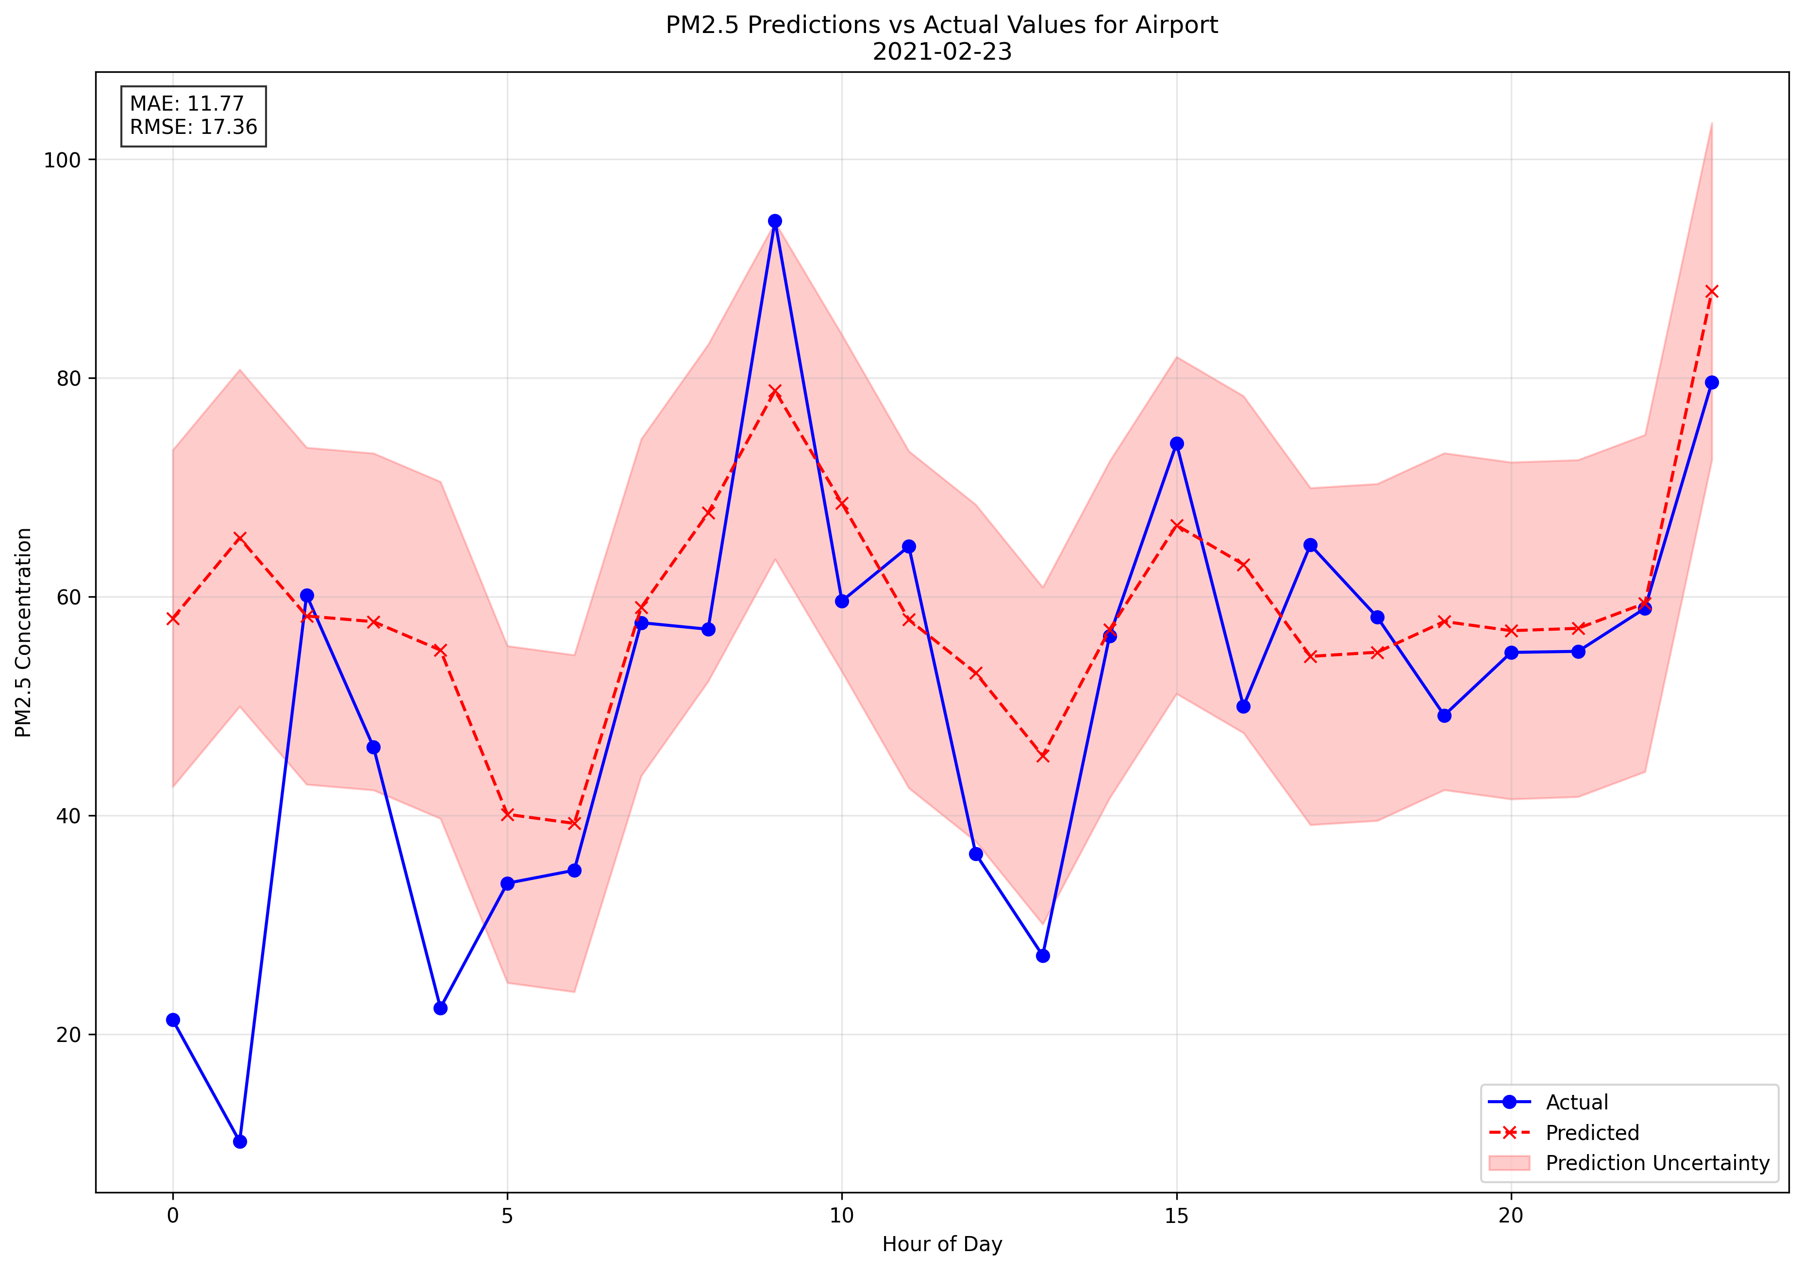
Ouput (Prediction vs Actual)
Loaded the model, found a date with complete data and performed prediction for it

Slide 20
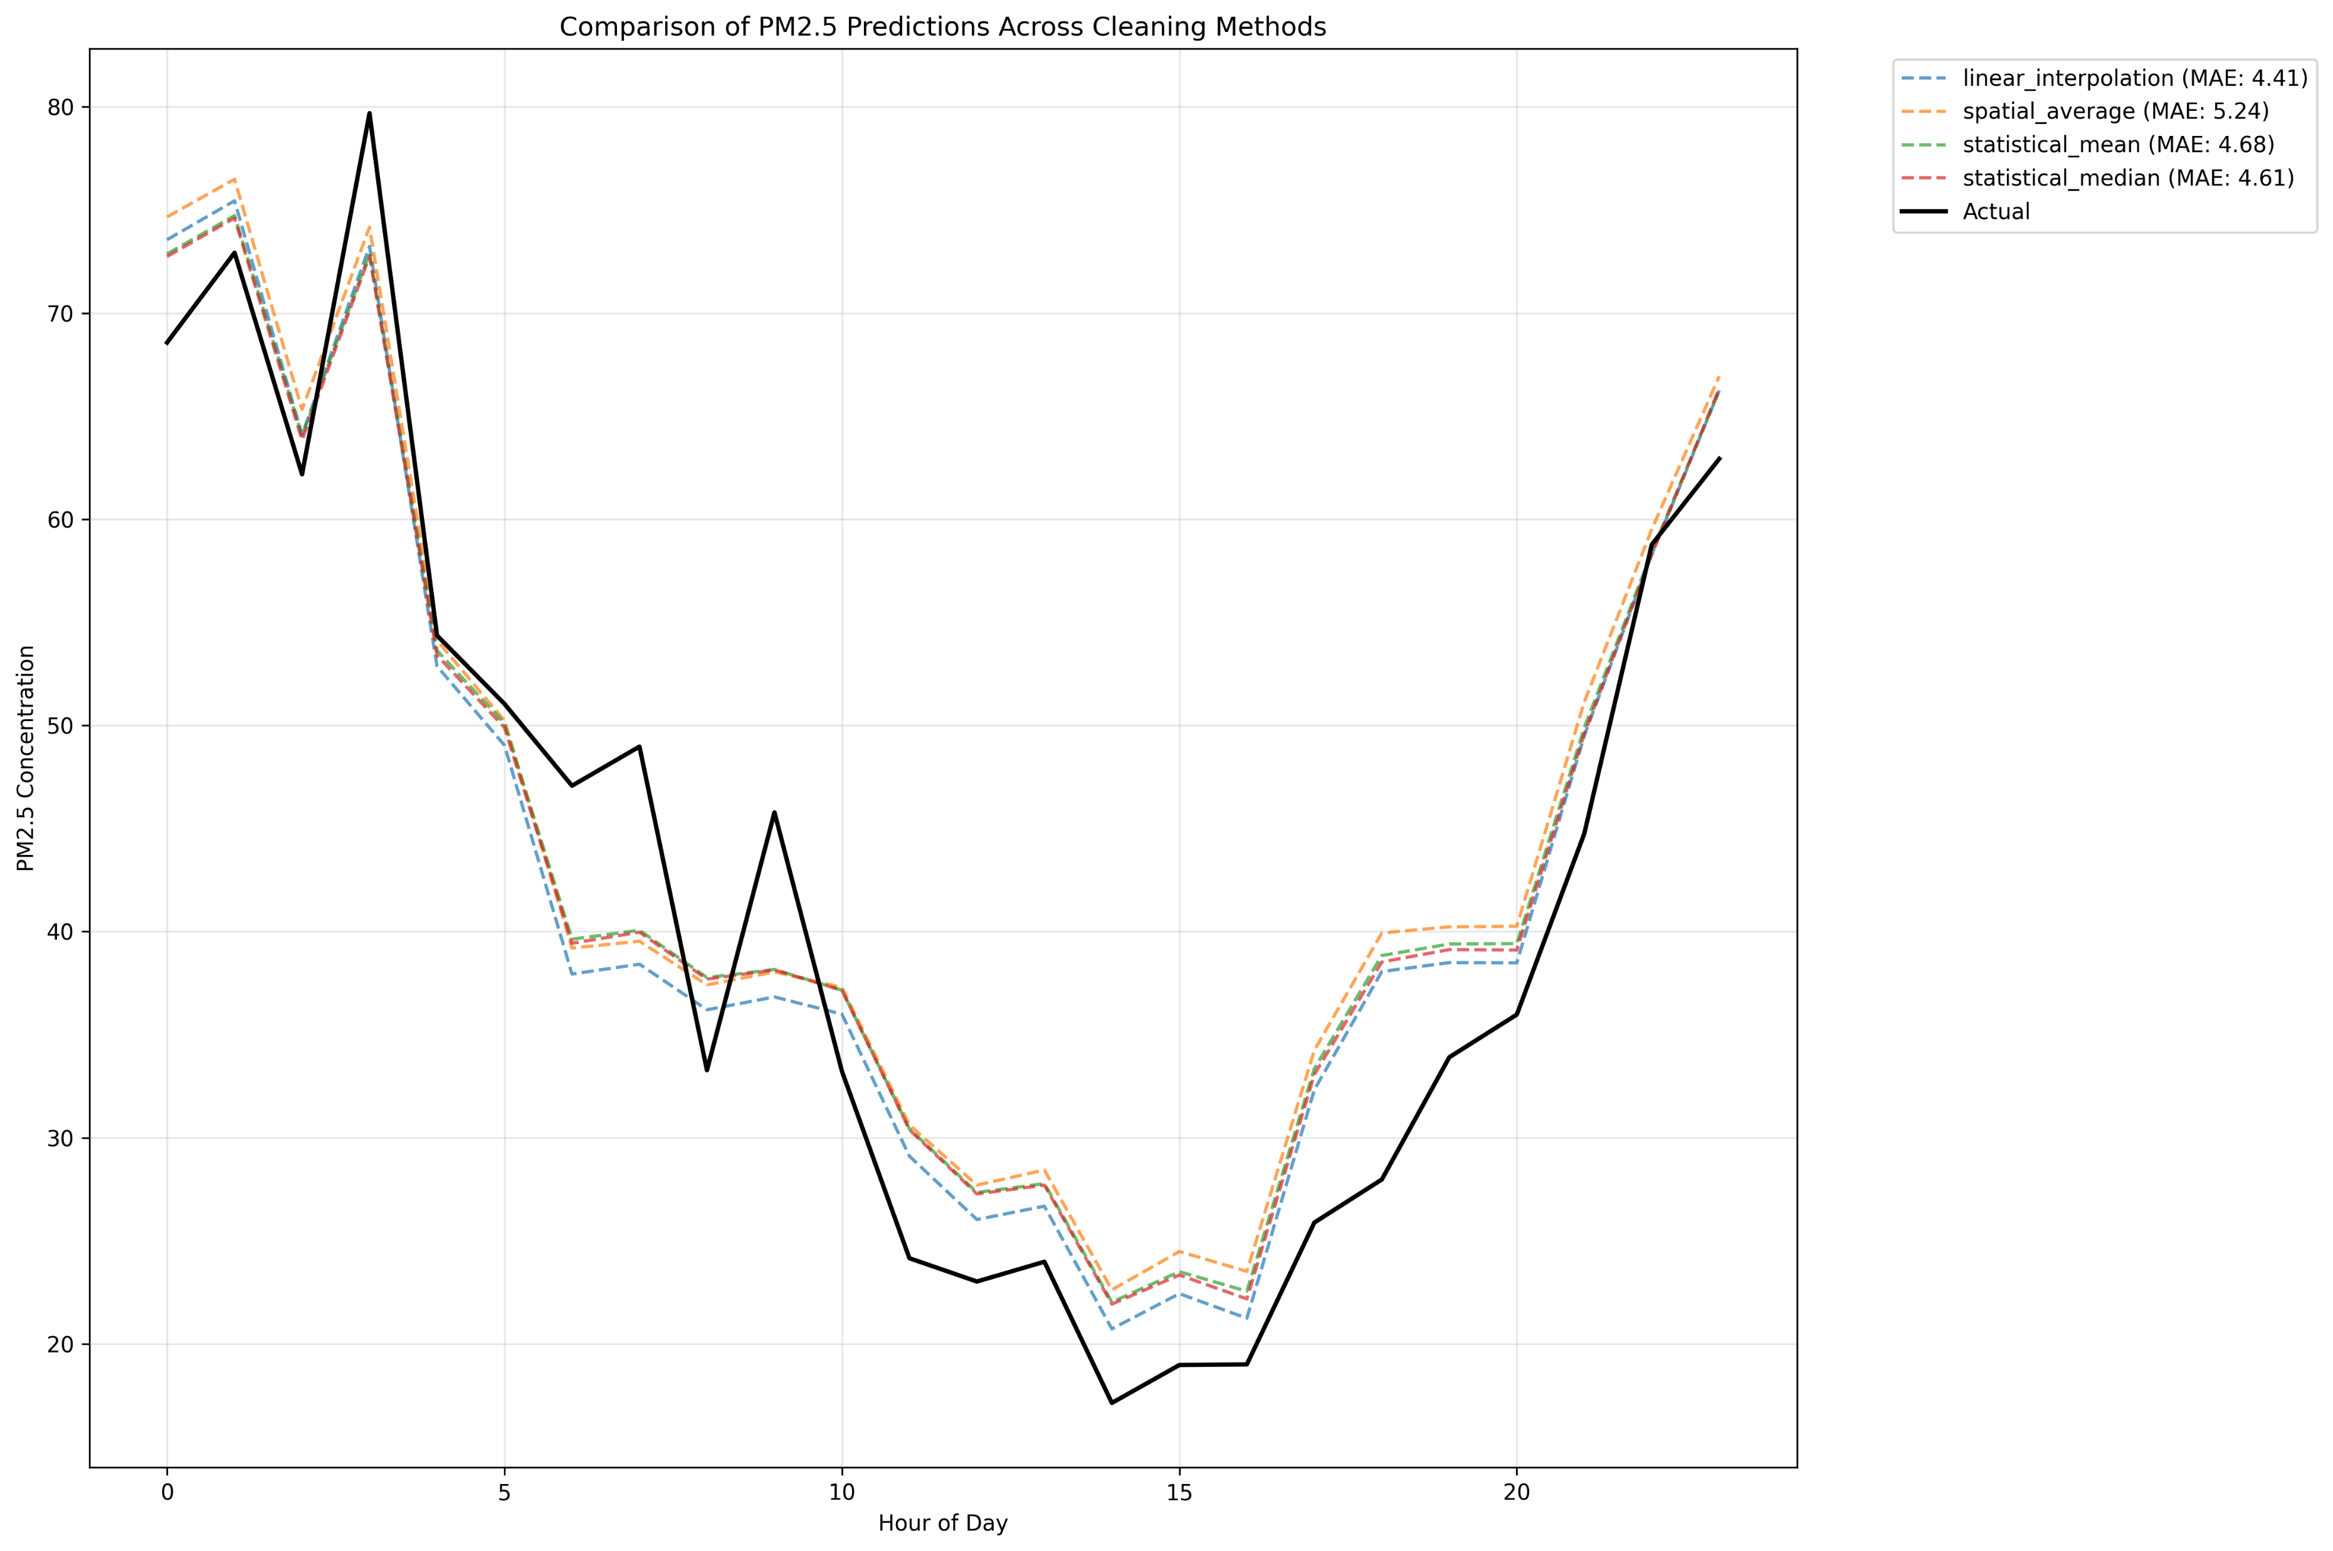
Cleaning method prediction comparisons
In this example linear regression closely followed the actual data
However all the methods worked relatively well

Slide 21
Next steps
Linear regression bets on the data being linearly related. We need to improve and test with better models
Test:
Polynomial regression
Gradient boosting
LSTM

